Slide 1

Equity and Assessment: Practical Approaches
Natasha Jankowski, NILOA and UIUC

Slide 2
Equity and Assessment
Student Roles
Assessment is not something we do to students it is something we do with students.
As a researcher
Think aloud on assignment intent
Co-create rubric
Design assignment
Write a letter to an incoming student on what they wished they knew or someone had told them
Validate that their learning matters
Notes:
There are many ways to show you know how to do something – why do only some demonstrations count in certain instances? Validates our students as learners – validates them Build from daily work of faculty in assignment, and culturally responsive assessment – equity lens added to it Help faculty understand the diversity in front of them Classroom teaching strategies as it relates to equity and diversity and advising lens – assignment think aloud Have students be active researchers – but if assessment is about measurement – these aren’t options and if it is about reporting they aren’t options either

Slide 3
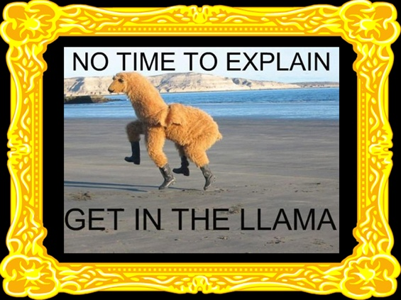
Student-Centered
Share the learning outcomes and their relevancy
Actively engage in reflection and transference
Undergraduate research – a High-Impact Practice: https://www.learningoutcomesassessment.org/wp-content/uploads/2020/03/AiP-Turos.pdf

Slide 4
Spectrum of Student Involvement
Decide what to change for others
Check in with students to see if they agree with final product
Students lead on identifying issues and solutions
Student as object of assessment
Student Representation on Committee
Examine student differences through data disaggregation
Blame Student for Differences
Examine Organizational Structures
Survey Students or Focus Groups

Slide 5
What we hear about student involvement…
What could students tell us that we don’t already know?
We already have a student on the committee.
We don’t have capacity or the time for such things.
Students barely engage in coursework, why would they engage in assessment?
Involving students in assessment delegitimizes, devalues, and invalidates the assessment process and data gathered.
Nobody cares about our students more than me, but, honestly, students don’t know what assessment is. They barely know what they want from their education. We know what is best for students.

Slide 6
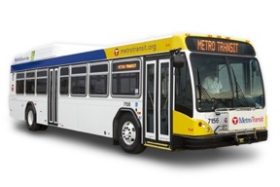
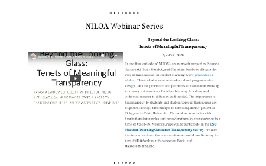

But students say…

Slide 7
Research says…
As Pastore and Pentassuglia (2015) state, “assessment is a ‘silent practice’, closed and not shared with students: a silent assessment that loses its empowerment and formative chance both for teachers and for students” (p. 418).
Reinforces sense of belonging (Boud, 2017); engages in deeper lasting learning (Martens, Spruijt, Wolfhagen, Whittingham, & Dolmans, 2019).
Students have perceptions and beliefs about assessment – they come from K-12 or work, they have experienced it differently (Sambell, McDowell, & Brown, 1997).
It begins with the concept that if students know what is expected of them, they will meet or exceed those expectations better than if they have to guess what they might be (Falchikov, 2005).
If assessment is about enhancing student learning as opposed to simply documenting it, then involving students is a vital approach to ensuring learning occurs (Brown, 2017).

Slide 8

What are we assessing?
Effort?
Privilege?
The Learning?
Cultural Capital?

Slide 9
Transparency in Assignments
Transparency in Learning and Teaching: https://tilthighered.com/
Purpose
Skills you’ll practice by doing this assignment
Content knowledge you’ll gain from doing this assignment
How you can use these in your life beyond the context of this course, in and beyond college
Task
What to do
How to do it (Are there recommended steps? What roadblocks/mistakes should you avoid?)
Criteria
(Are you on the right track? How to know you’re doing what’s expected?)
Annotated examples of successful work
(What’s good about these examples? Use the checklist to identify the successful parts.)

Slide 10
Questions for Assignment
What learning outcomes will students demonstrate with this assignment? How does it need to be modified to better align with the learning outcomes of interest?
How does the assignment align with the evaluative criteria? Are there mixed signals sent to students?
Thinking about the assignment from the point of view of students, what questions or suggestions do you have?
How does this assignment allow for flexible options, alternative demonstrations, and/or culturally responsive demonstrations of learning?
How does this assignment need to be modified or adjusted to reflect current faculty and student circumstances and situations?
What unnecessary constraints, if any, may need to be removed to accommodate learning in a global pandemic crisis?

Slide 11

Share
What other ideas within a classroom or online might you share to engage in culturally responsive or equity-minded assessment?

Slide 12
Having Hard Talks
How ought we assess to be responsive to minority students?
How do we think about our responsibility for minority student outcomes?
How do we think about equity?
How do we know who benefits from the initiatives, innovations, and programs that we are so proud of?
How do the assumptions we make about our students disadvantage them?
How do best practices take race and equity into account?
~Bensimon, 2012

Slide 13
Foundational Assumptions
If we do equity work in assessment, assessment is positioned squarely out of the compliance box
Higher education as an enterprise has been and continues to be, a product of social construction (Harrison & Price, 2017)
Everyone has limiting higher education narratives – limiting to our ability to make changes – because of which students we think can be successful where and in what ways.

Slide 14
Interacting with Data

Slide 15
Definition
“Stereotypes, omissions, and distortions all contribute to the development of prejudice. Prejudice is a preconceived judgment or opinion, usually based on limited information. I assume that we all have prejudices, not because we want them, but simply because we are so continually exposed to misinformation about others.” (Tatum, 1997, p. 5)

Slide 16

Share
What other ways might we re-think policies and practice to advance equity issues?

Slide 17

COVID-19 Considerations
Pass/Fail
Cameras on
Cheating/Proctoring software
Access and technology
Others?

Slide 18
Resources

Slide 19
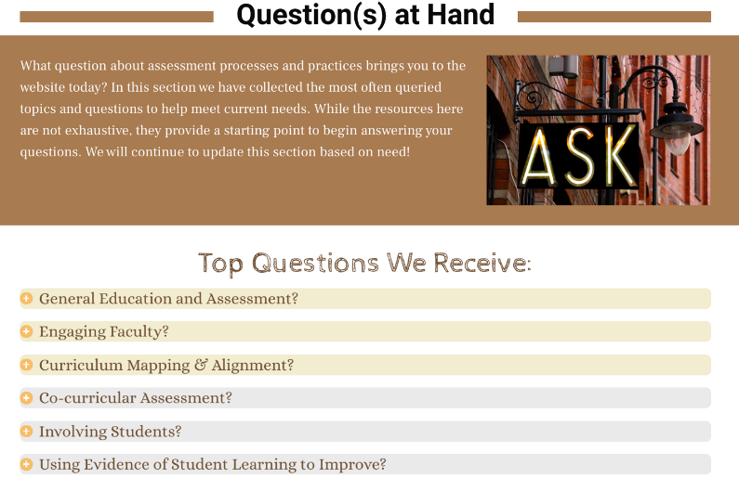

Slide 20
Student Involvement

Slide 21

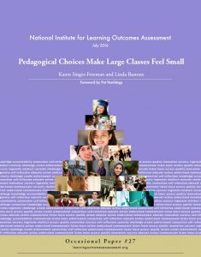

Slide 22
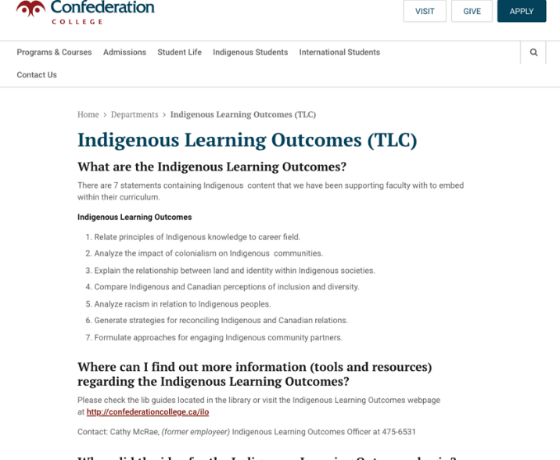
https://www.confederationcollege.ca/tlc/indigenous-learning-outcomes

Slide 23

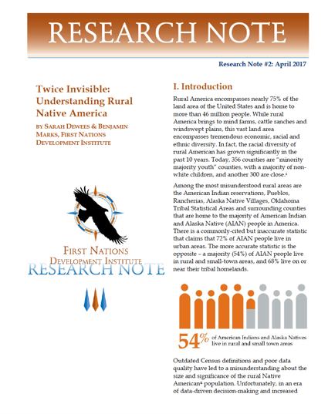

Slide 24
